Slide 1
Assignment-Discussion POS Tagging Using HMM
210050001, 3rd Year, CSE
210050126, 3rd Year, CSE
210040139, 3rd Year, Mech

Slide 2
Problem Statement
Given a sequence of words, produce the POS tag sequence
Technique to be used: HMM-Viterbi
Use Universal Tag Set (12 in number)
5-fold cross validation
Tag_List = {'NOUN', 'VERB','ADV', 'ADJ', 'PRT', 'DET', 'CONJ', '.', 'ADP', 'PRON', 'X', 'NUM’}

Slide 3
Overall performance
Precision : 0.9546080893951563
Recall : 0.9538759845493135
F-score (3 values)
F1-score: 0.9540233328995054
F0.5-score: 0.9543224882476086
F2-score: 0.9538815616660485

Slide 4
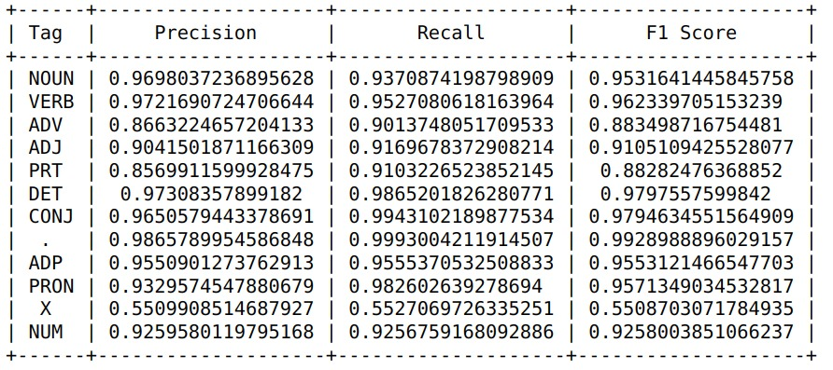
Per POS performance

Slide 5
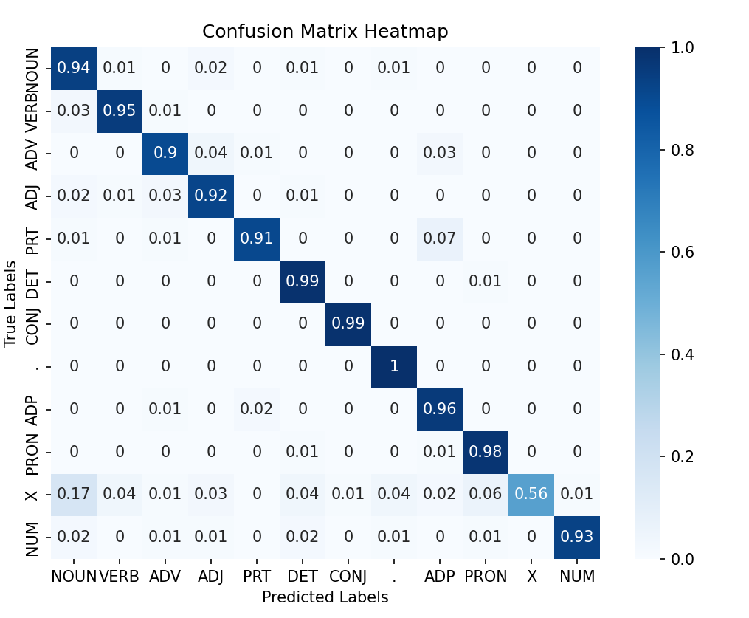

Slide 6
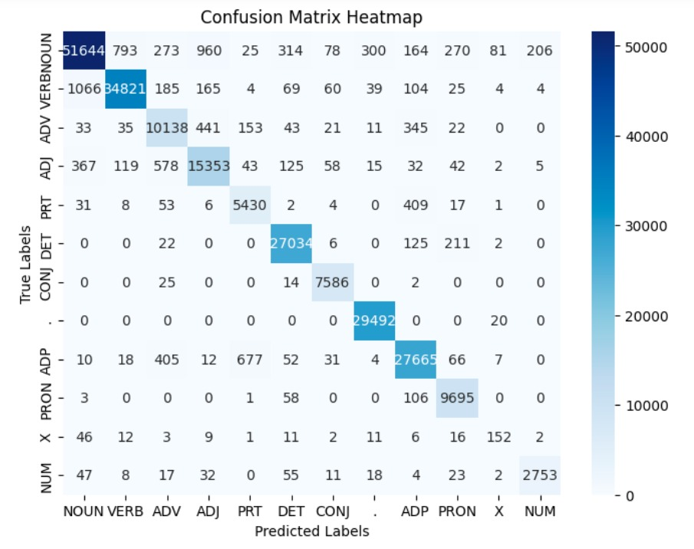

Slide 7
Interpretation of confusion (error analysis) [1/2]
Clear outlier: ‘X’ tag has the worst precision and recall (around 0.5), most often confused with ‘NOUN’
Reasons for bad precision
Ambiguity with nouns predominantly emerges from the utilization of multilingual content, as exemplified by phrases like "déjà vu“
Limited X-X true positives, compared to plentiful X-NOUN, greatly decreases precision
Reasons for bad recall
Low transition probabilities associated with the 'X' tag result in its overprediction as 'NOUN’
Different formats, different contexts
Too many multilingual texts, not many in the dataset

Slide 8
Interpretation of confusion (error analysis)[2/2]
PRT vs ADP: The model struggles to distinguish between particles (PRT) and adpositions (ADP) such as 'on' and 'at' due to contextual nuances
ADJ vs ADV: Distinguishing between ADJ and ADV, both describing qualities, poses a challenge
NOUN vs VERB: A high frequency of instances where nouns and verbs share similar forms

Slide 9
Data Processing Info (Pre-processing)
Tokenization: input text data is initially tokenized into individual words or tokens
Lowercasing: all words in the text are converted to lowercase, so that the model treats words with different cases
Special Character Removal: special characters and punctuation not relevant for POS tagging are removed

Slide 10
Inferencing/Decoding Info
Objective: Implementing the Viterbi algorithm for Part-of-Speech Tagging
Inputs: Tag-to-word probability dictionary, transition probability matrix, input sentence
Processing:
Iterate through each word in the input sentence
For each word, iterate through the current tag sequences
Calculate the lexical probability of the word given the tag using the probability dictionary
Calculate the transition probability from previous tag to the new tag using the transition matrix
Retain the top (max_entries) tag sequences formed with the highest probability, and repeat
Output: tag sequence with highest probability

Slide 11
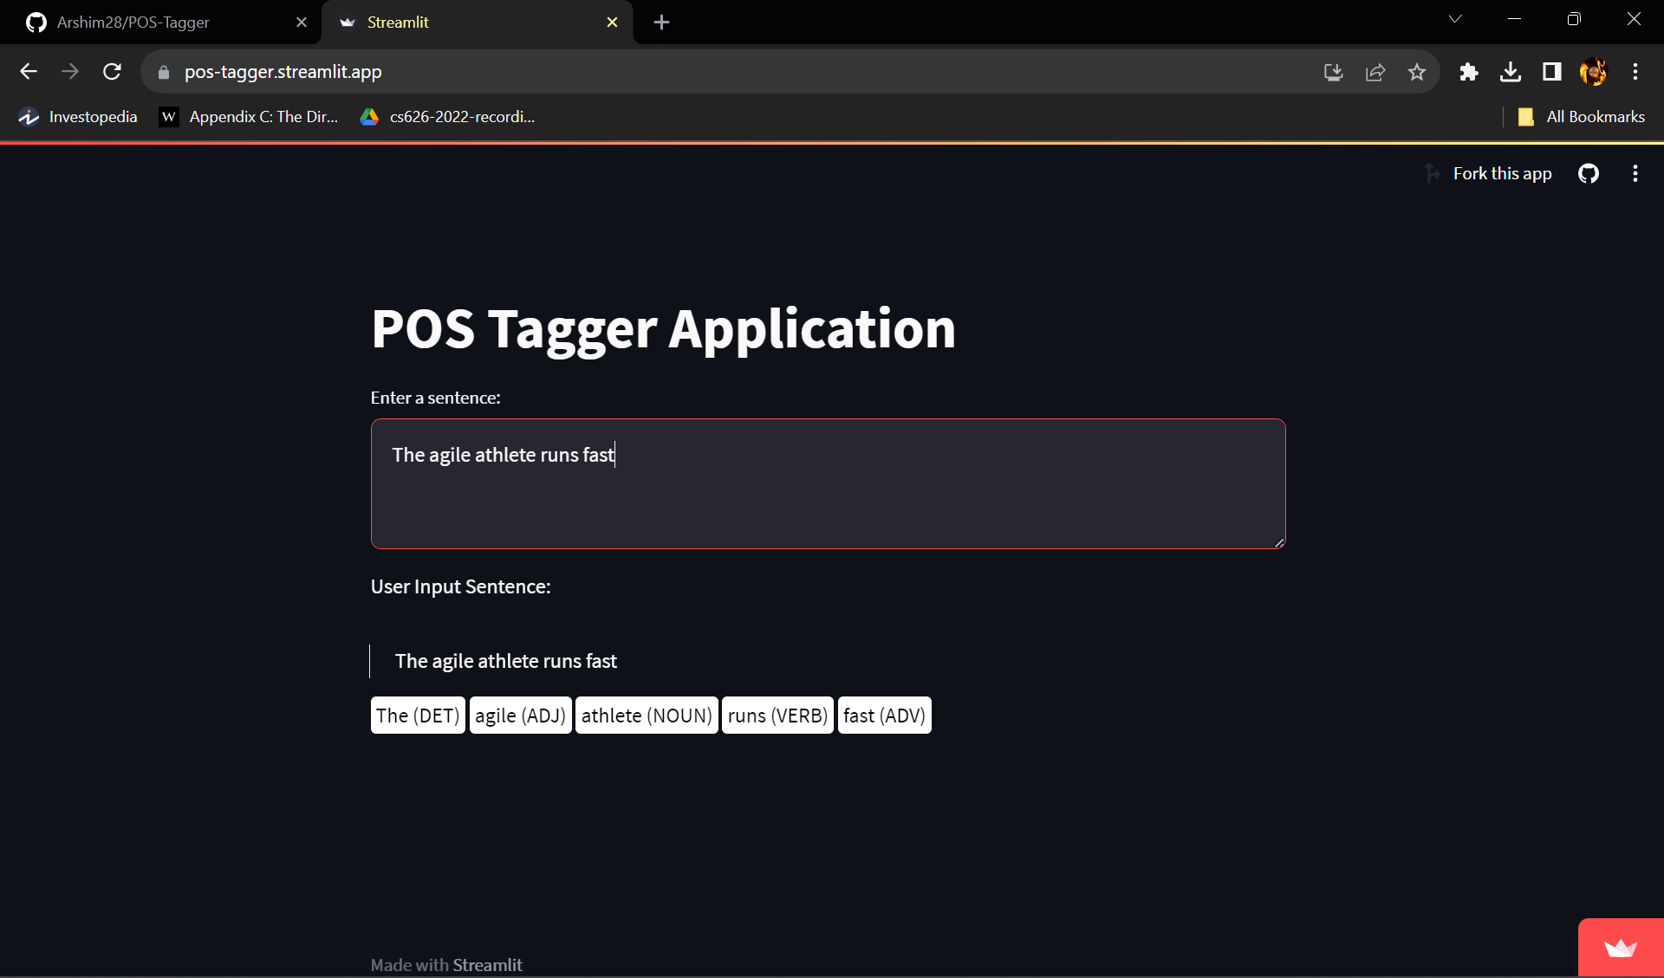
Demo

Slide 12
Any thoughts on generative vs. discriminative POS tagging
Generative
Harder to encode diverse information with respect to words and sentences
Generative models like HMMs would tend to work better with smaller datasets
Easier to interpret parameters, in general
Discriminative
Easier to encode linguistic and contextual features for words and sentence structures
Discriminative models would require more data, and more kind of data, to work well
More difficult to interpret parameters

Slide 13
Marking Scheme
1. Demo working- 10/10 (if not, 0)
2. Implemented Viterbi and Clarity on Viterbi- 5/5
3. Transition and Lexical tables clearly described- 5/5
4. Confusion matrix drawn and error analysed- 5/5
5. Overall F-score > 90- 10/10, >80 & <=90- 8/10, else 6/10
6. Unknown word handling- done (5/5; else 0)

